Slide 1
Introduction to Graphics Final Project
Ray Tracer
Chaewoon Park
20531074

Slide 2
Objectives
Completed:
Motion Blur
Soft Shadows
Regular Sampling (Antialiasing)
Texture Mapping
Depth of Field
Glossy Reflection
Refraction
Glossy Transmission
Final Scene
Incomplete:
Animation
A4 Objective: Reflection

Slide 3
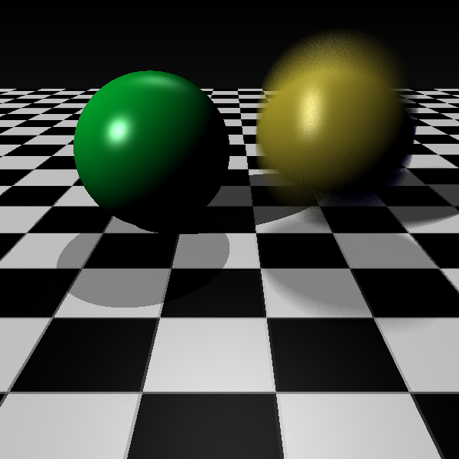
Motion Blur

Slide 4
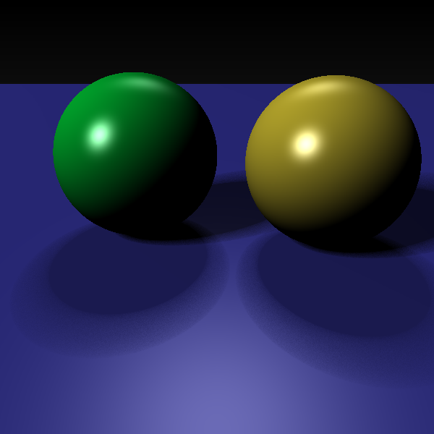
Soft Shadows

Slide 5
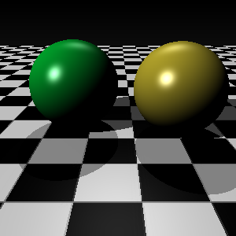

Regular Sampling

Slide 6
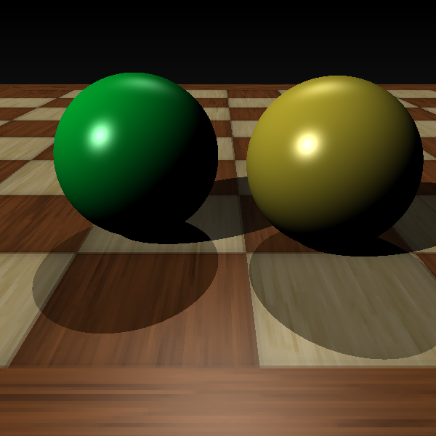
Texture Mapping

Slide 7
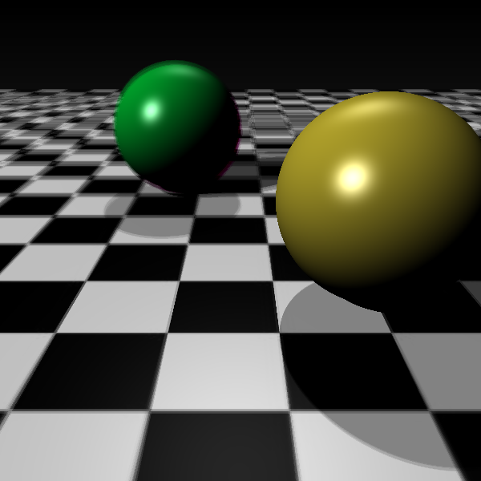
Depth of Field

Slide 8
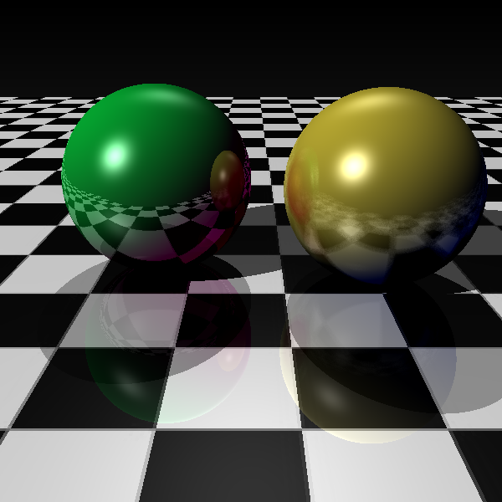
Reflection and Glossy Reflection

Slide 9
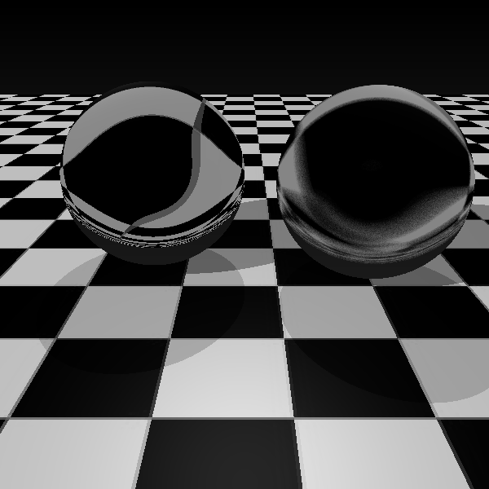
Refraction and Glossy Transmission

Slide 10
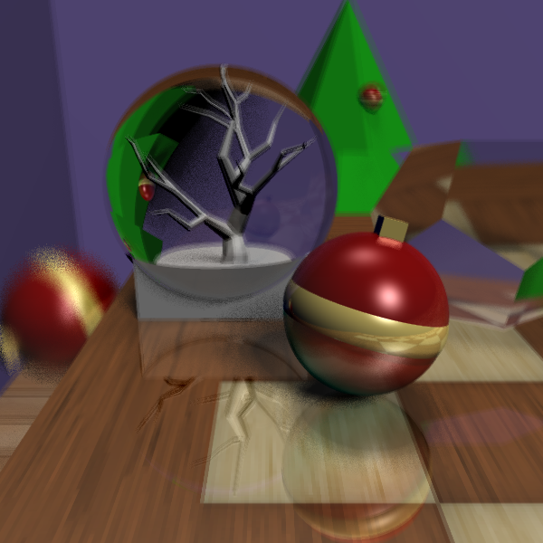
Final Scene

